Slide 1

City Bike Analytics
Adam Fletcher

Slide 2
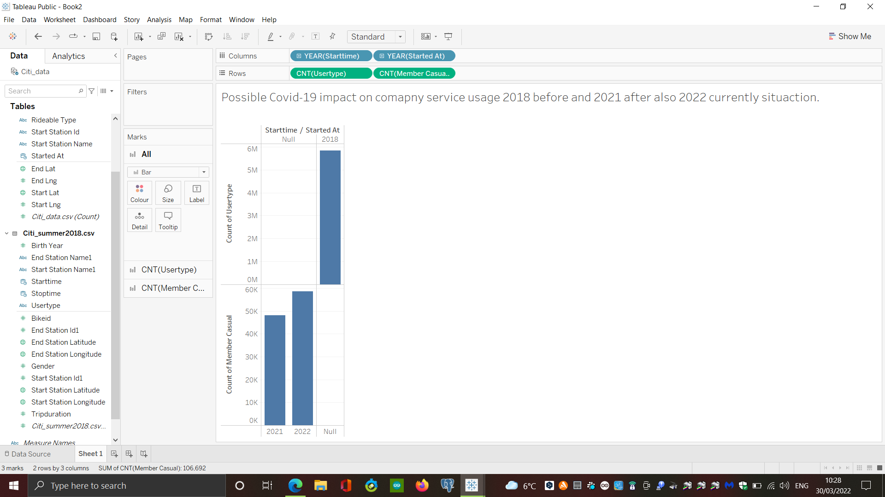
Possible Covid-19 impact on company service usage
2018
Results shows first of all in 2018 usage about 60k during summer time.
2020
In 2020 after Covid-19 outbreak, summer time shows visible impact on service. Usage drop up 48,021 and grow
2022
on 2022 at 58,671 this is more then 10,000 in reason.

Slide 3
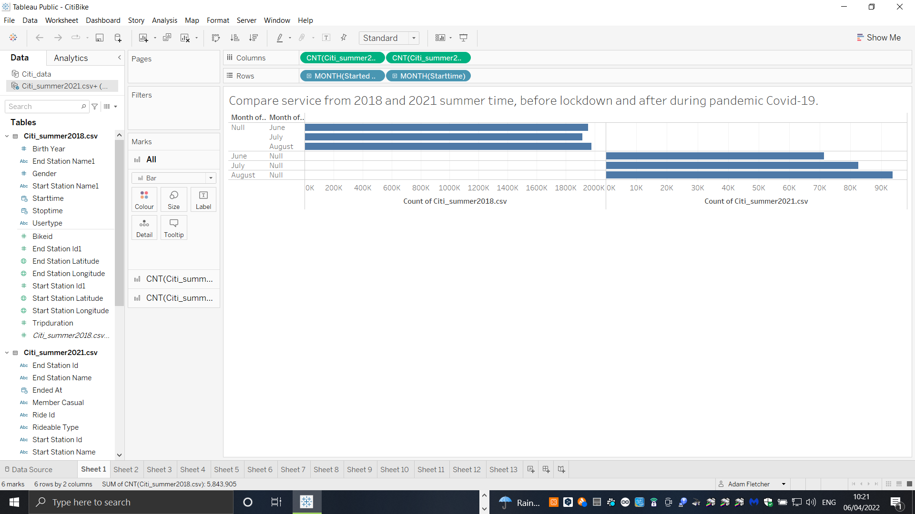
Service on summer time 2018 and 2020
Compare service from 2018 before pandemic Covid-19 time and during second pandemic year 2021 shows definitely that before pandemic time service usage during summer time is larger then in 2021 in the second year of pandemic in the same summer time.

Slide 4
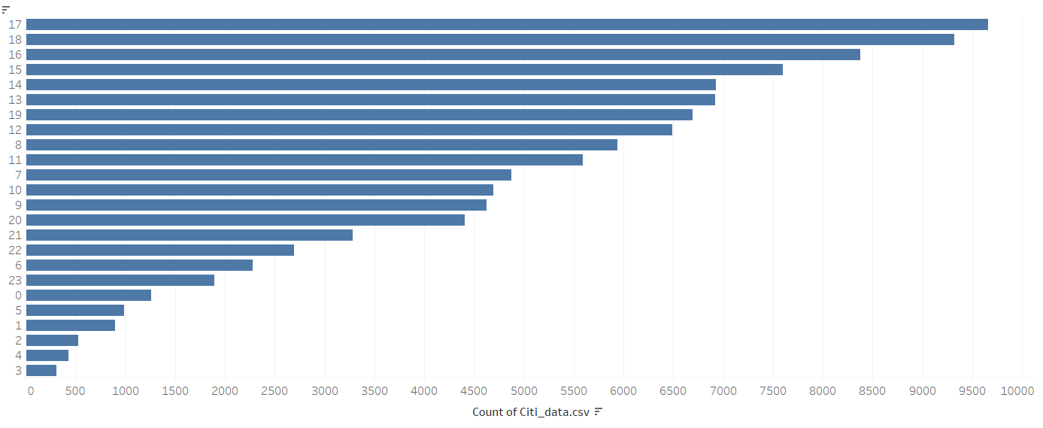
Peak hours 2021/22
Data shows that the
service usage
grow from 3pm and
the best hour is 5pm

Slide 5
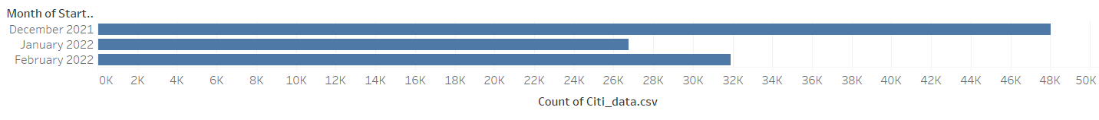
Using of service on a monthly basis 2021/2022
Data proof that the best for service time
During winter is December, there is visible drop of using service on January
From 48K to nearly 27K
And from February service grow again.

Slide 6
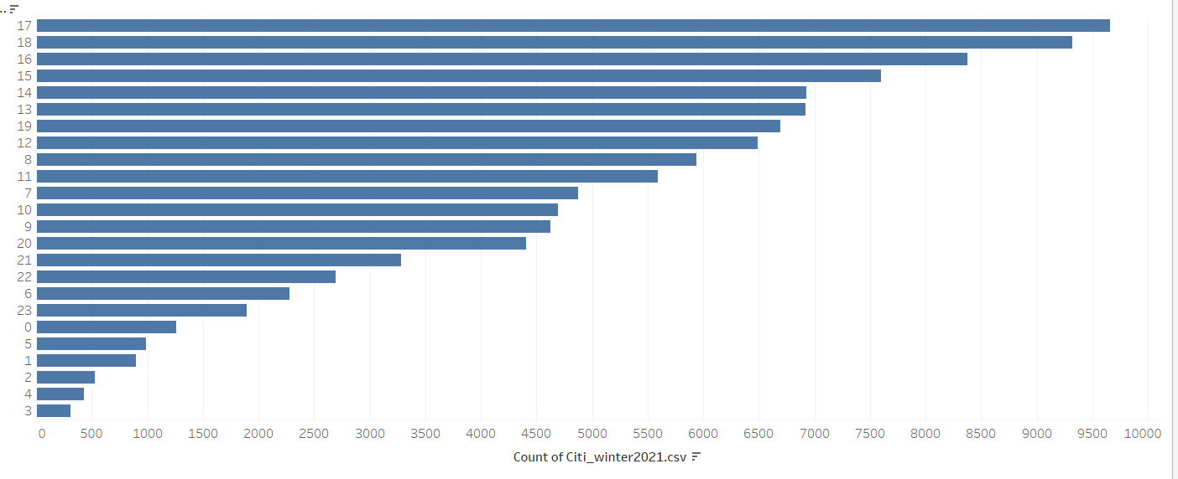
Peak hours during winter
Peak hours during winter are very similar to a summer. The busiest hour is 5pm.

Slide 7
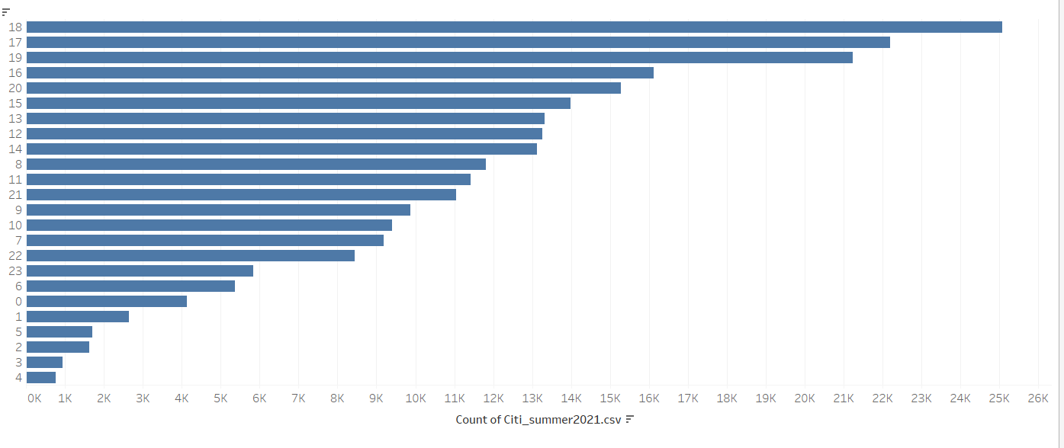
Peak hours during summer
Peak hours of summer 2021 very similar to winter.

Slide 8
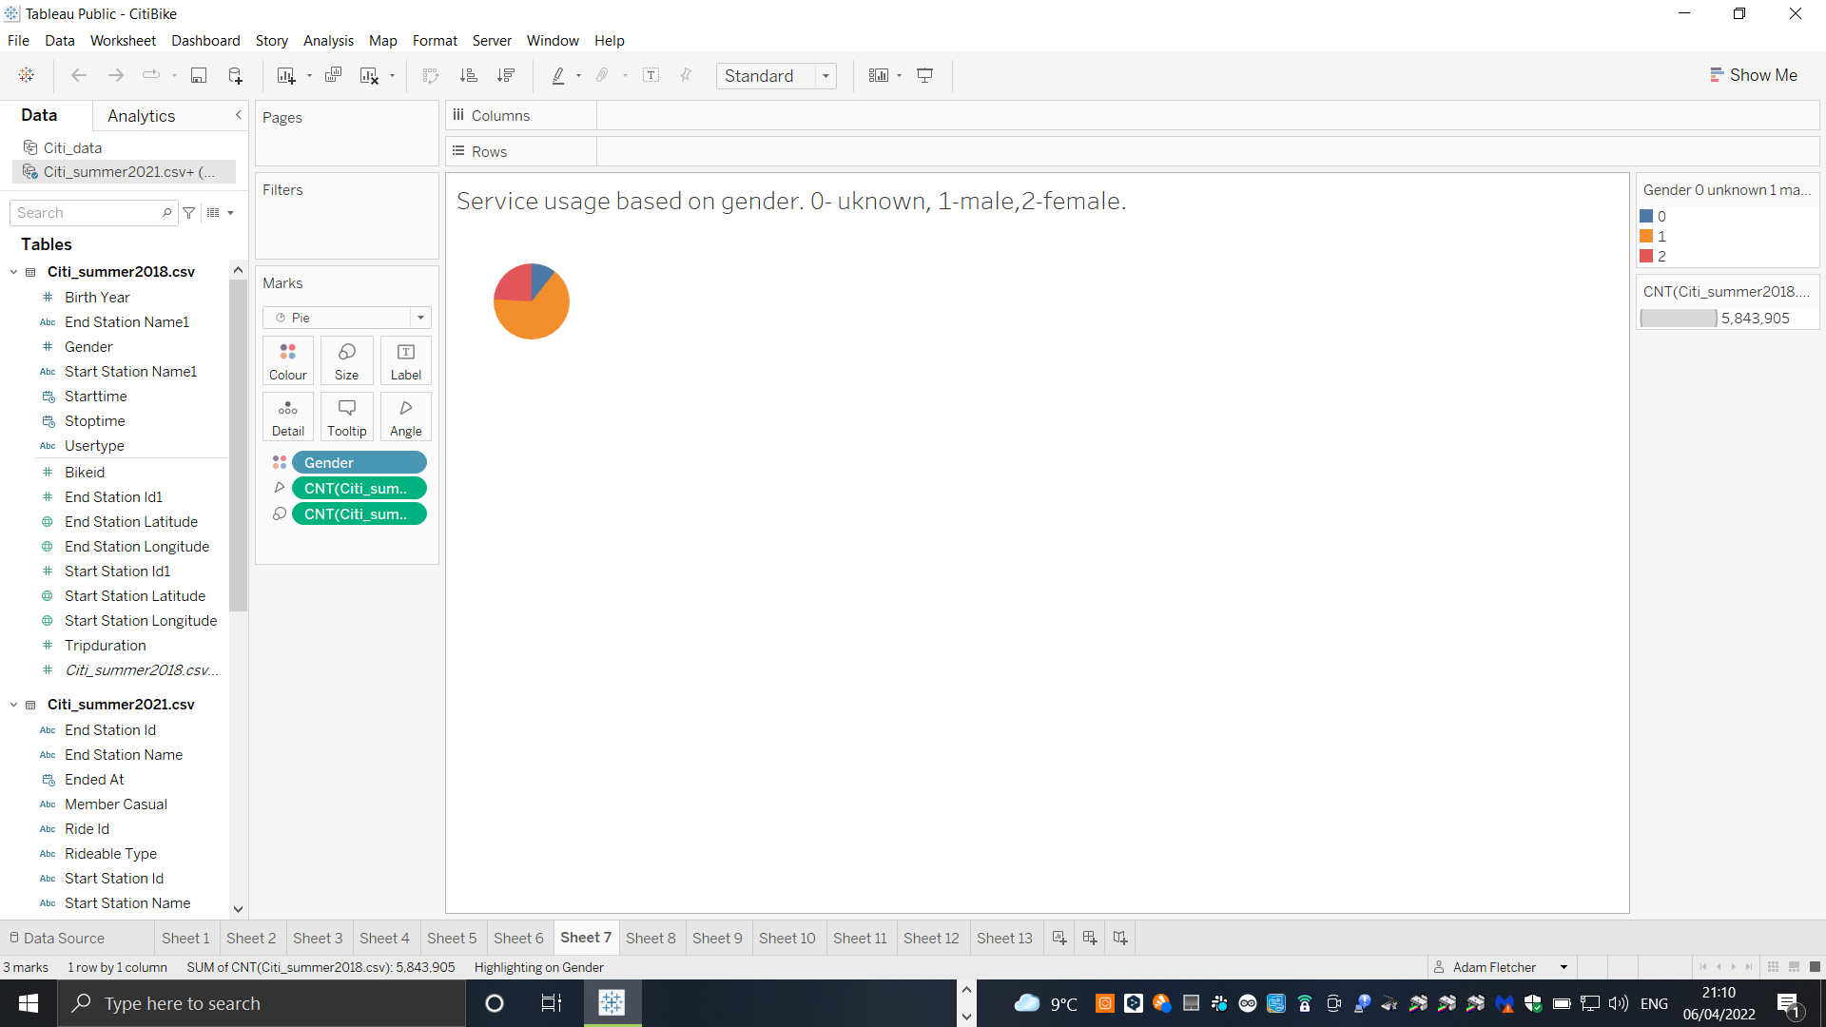
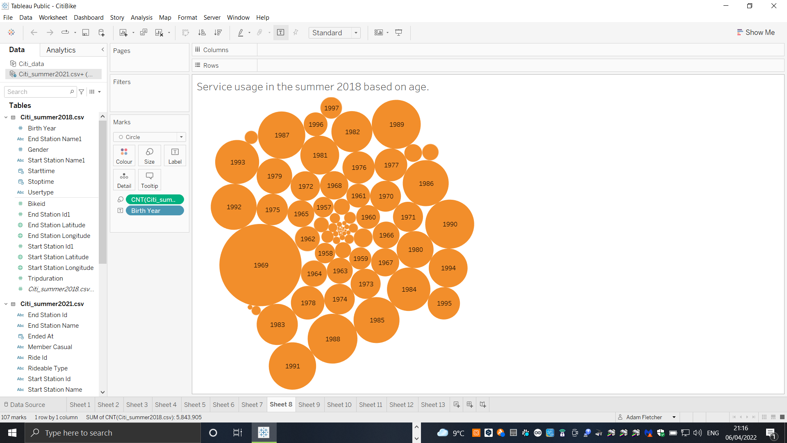
Service based on customer gender and age
Majority of customers are male, almost 3 times more than female. Service used the most by people aged 53 years old and in age 30th

Slide 9
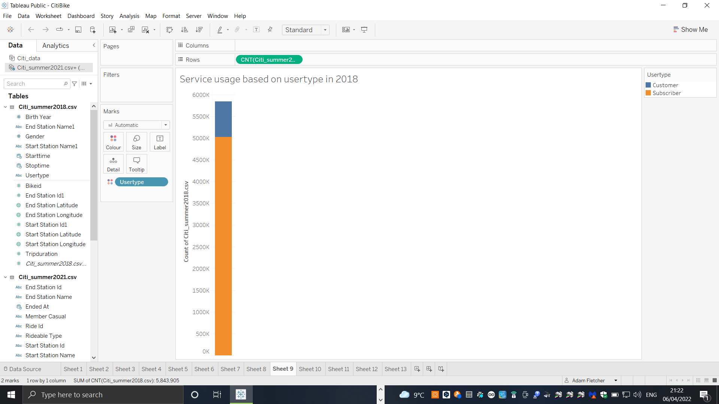
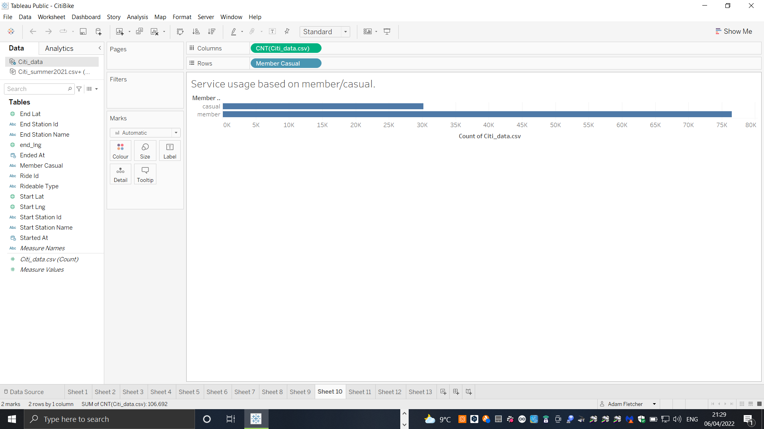
Service based on user type
Majority of service used by subscribers
Members of service

Slide 10
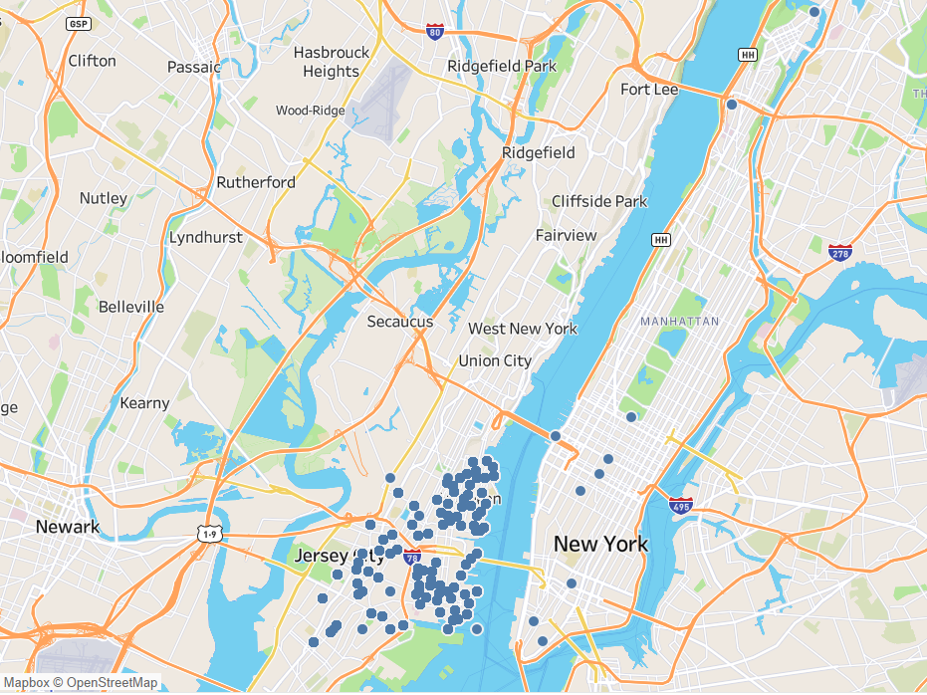
The most used stations
Map shows the most used station
In Jersey

Slide 11
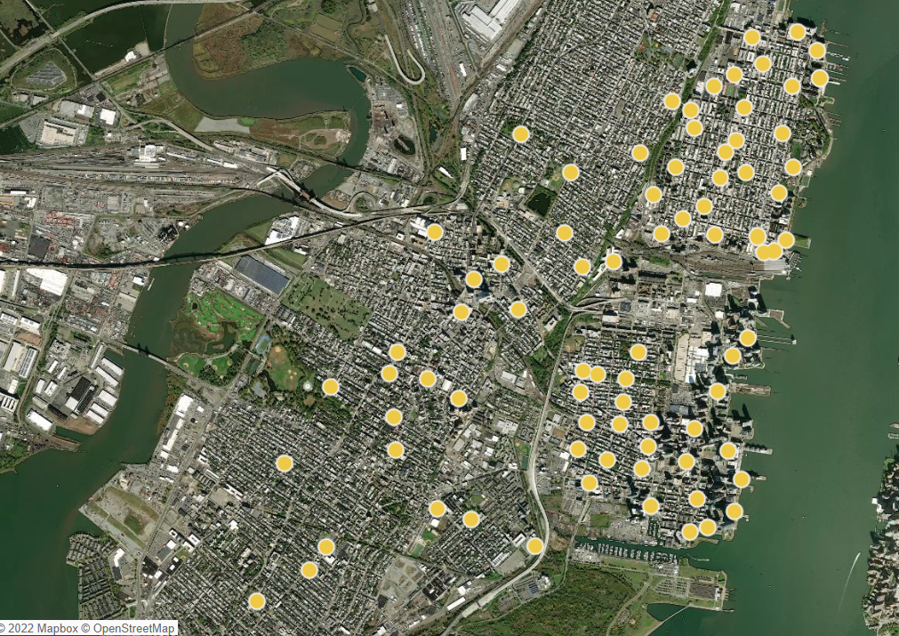
Service based on stations
During winter months most of
used stations are the same during the year.
Probably because of the
Working customers.

